Slide 1
Telecommuication
An Introduction
Christy Henitha JV
17th January, 2020

Slide 2
Table of Contents
1. History of telecommunication
2. Communication & telecommunication
3. Telecommunication Components
4. Types of telecommunication
5. Telecom Industry
6. Business process in telecom industry
7. Telecom Testing
8. Social impact of telecom industry
9. Future of telecommunication
10. Evaluation

Slide 3

1. History of telecommunication

Slide 4
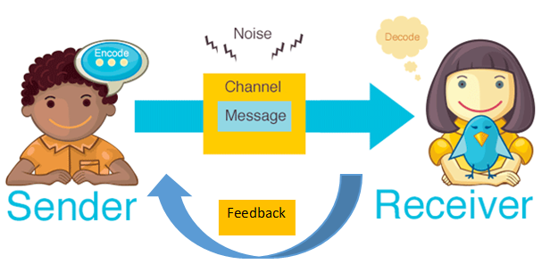
2. Communication & telecommunication
Communication occurs when there is exchange of information between sender and receiver.
When the exchange of information between participants includes the use of technology, it is called as Telecommunication

Slide 5
2. Communication & telecommunication
Telecommunication is the transmission of signs, signals, messages, words, writings, images and sounds or information of any nature by wire, radio, optical or other electromagnetic systems.
The word telecommunication was adapted from the French word telecommunication. Greek prefix tele-, meaning "far off", and the Latin communicare, meaning "to share".

